Slide 1
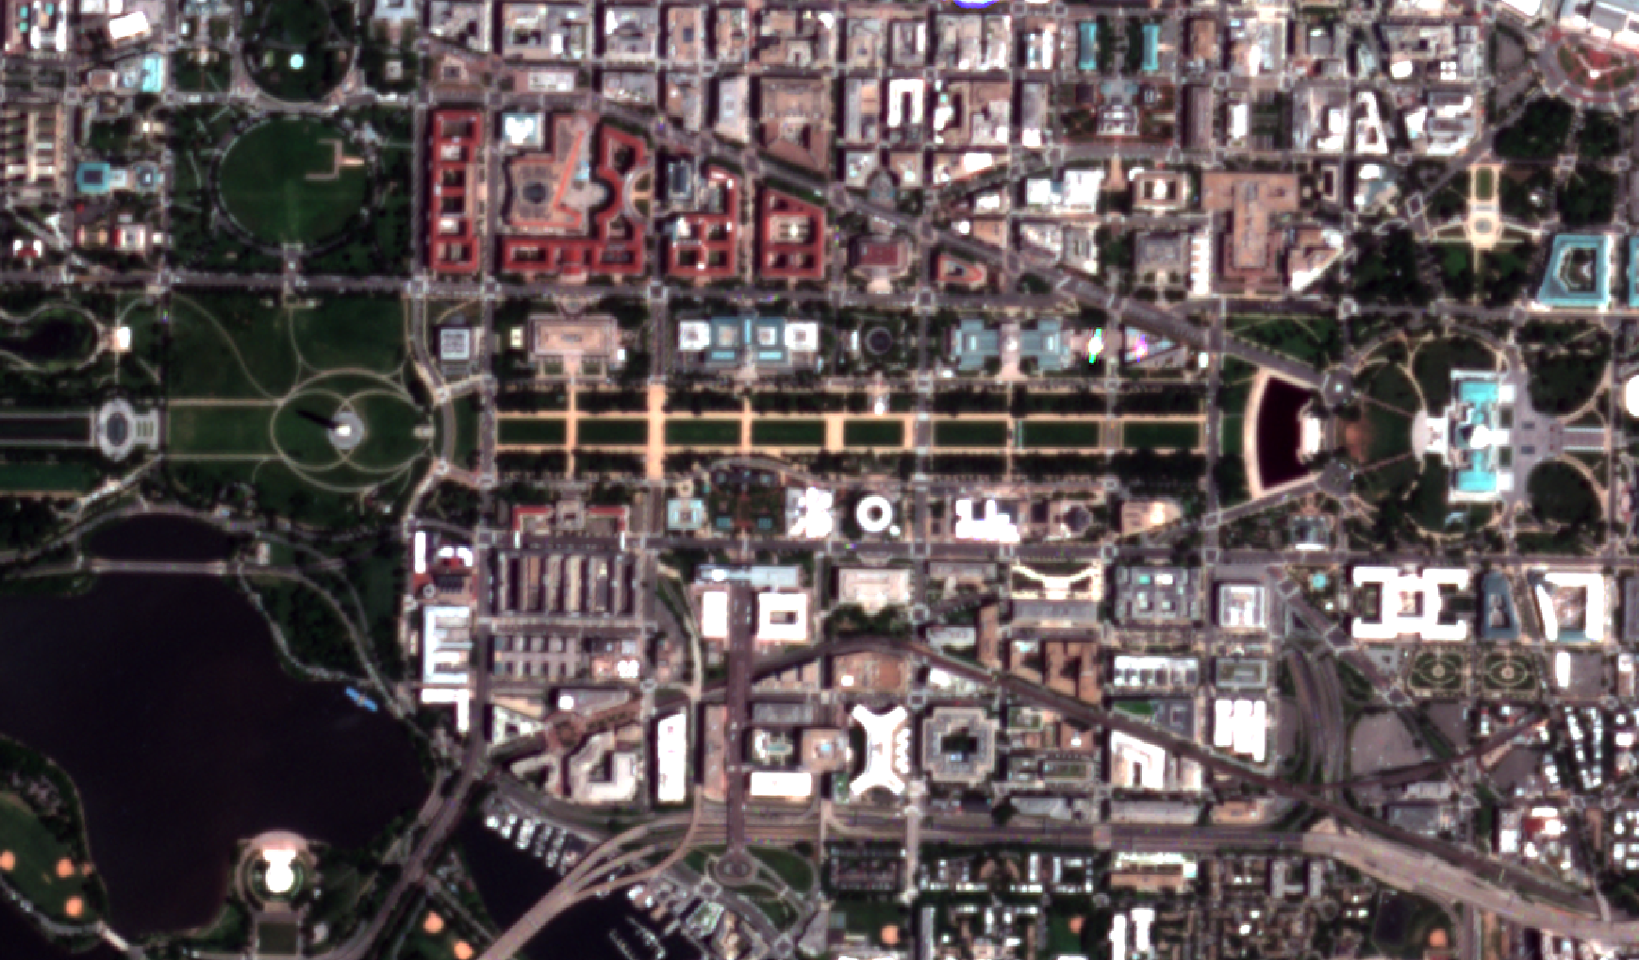
Mapping rooftop material in Washington, D.C. with PlanetScope Imagery and Building Footprints Maxwell Cook, Cibele Amaral, Johannes Uhl, Stefan Leyk, Jennifer Balch Funding: Open Philanthropy Project (OPP) Earth Lab GRA, Summer 2023
Notes:
My name is Max Cook, and I’m a Geography PhD student with Dr. Jennifer Balch.
As you can see, I’m not here in person while I attend the Colorado Aspen workshop in Pagosa Springs.
However, I’m excited to share progress on my Earth Lab GRA focused on mapping rooftop material in urban environments.

Slide 2
Natural hazards (e.g., wildfires, tornados, earthquakes, and hurricanes) are posing significant risk to society and the built environment
“57% of structures (homes, schools, hospitals, office buildings, etc.) are located in hazard hotspots, which represent only a third of CONUS area, and ∼1.5 million buildings lie in hotspots for two or more hazards”
Iglesias et al. (2023)
Notes:
As many of you know, or have experienced yourselves, natural hazards are increasingly posing risks to communities and the built environment.
Recent work from here in the Earth Lab showed that 57% of structures are located in hazard hotspots and around 1.5 million structures are at risk for two or more hazards.

Slide 3
Characteristics of the built environment (e.g., materials flammability, arrangement of structures) influence the outcomes of natural and human-made hazards (e.g., structure loss, emissions from smoke, etc.)
Notes:
The unique characteristics of the built environment influence the outcomes of these hazards, whether natural or human-caused (or both).
Things like building materials, structure arrangement and density have significant effects on the potential outcomes of disasters.

Slide 4
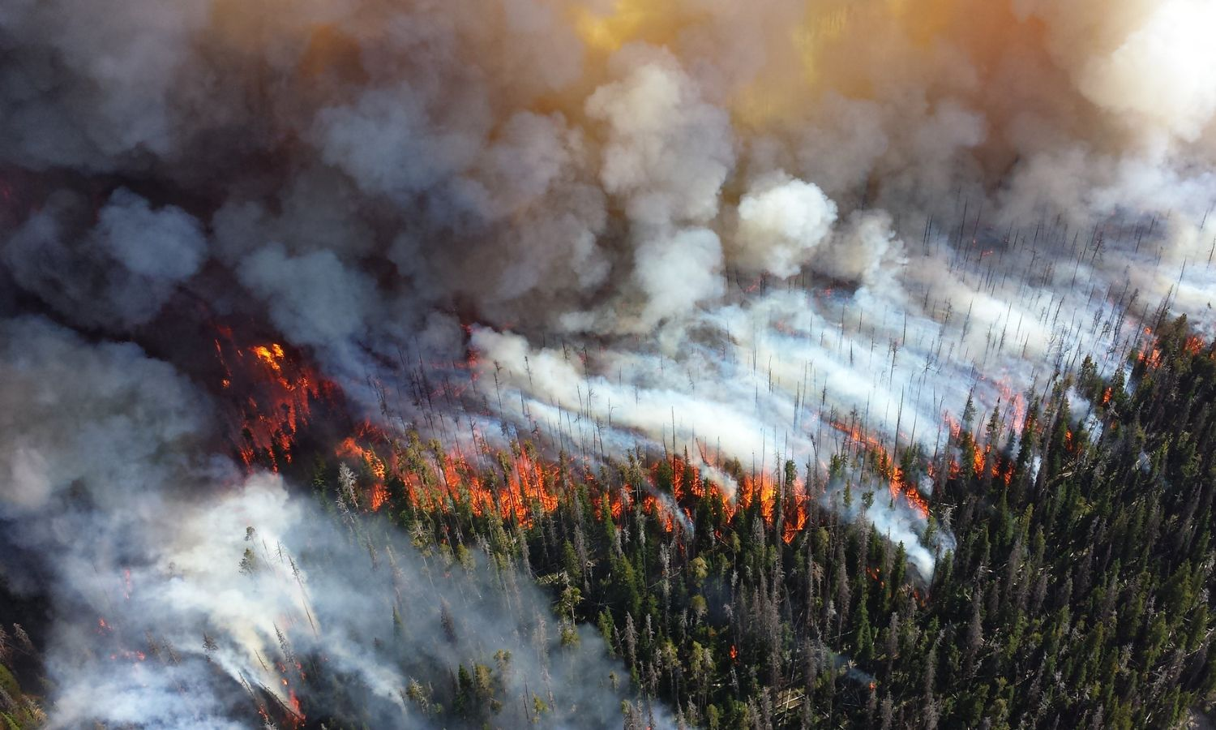
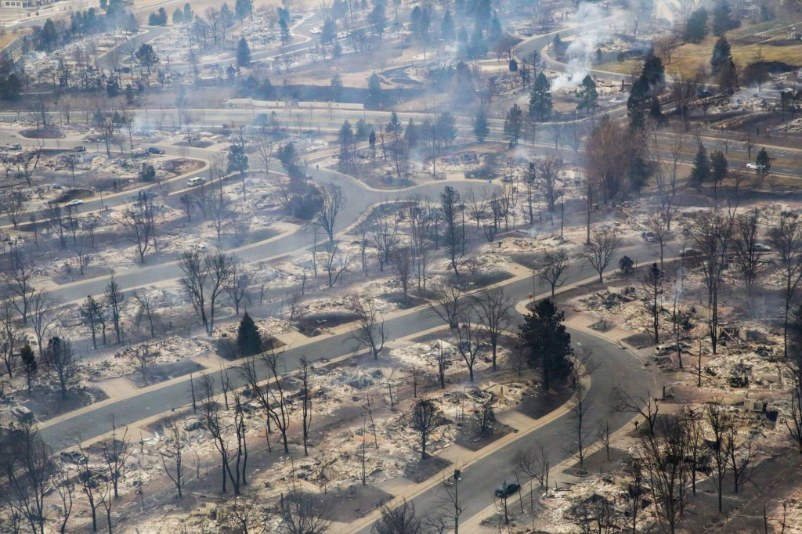
In the context of wildfire …
Extensive research has been done quantifying vegetative fuel on the landscape.
Less has been done to understand the urban fuel landscape.
https://blog.ucsusa.org/shana-udvardy/as-danger-season-begins-congress-must-pass-stronger-wildfire-policies/
https://www.denverpost.com/2021/12/31/marshall-fire-boulder-county-friday/
Notes:
In the context of wildfire;
Extensive research has been done quantifying vegetative fuel on the landscape.
However, far less has been done to quantify the urban fuel landscape.
As wildfire disasters continue to impact communities, better data is needed to help plan and mitigate for impacts.

Slide 5
Wildfire is one application (admittedly, my personal focus), but other human-caused disasters such as nuclear war (a specific interest of the OPP project) require a better understanding of the flammability of our built environment.
Notes:
Wildfire is admittedly my personal focus for this work.
However, the OPP project is interested in understanding the risks associated with human-caused disasters such as the threat of nuclear war.
While this is a sobering thought, understanding the characteristics of the built environment will help society better plan for different scenarios.

Slide 6
Roofing materials present a unique opportunity to leverage remote sensing technologies to map one important characteristics of the built environment.
Notes:
Rooftop materials are an important piece of the urban fuel puzzle.
Given their location, rooftops are observable from satellite and airborne remote sensing technologies, making them a prime candidate for large-scale mapping efforts.

Slide 7
Research Goal
Develop methods, with D.C. as a case study, to identify roofing material type using a combination of building footprints, Zillow ZTRAX information, and PlanetScope multispectral imagery.
Notes:
To this end, the goal of our research is to develop new methods for mapping rooftop materials using a combination of building footprints, Zillow attribute data, and PlanetScope SuperDove multispectral imagery. We will use Washington D.C. as a case study for this work.

Slide 8
Data Preparation
Download PlanetScope SuperDove (8-bands)
Zillow ZTRAX
Open Street Map (OSM) Building Footprints
Spectral Mixture Analysis (SMA)
-Training Data Selection
Classification and Summary
Image composite & color balancing
Building footprints w/ joined Zillow attr.
Calculate spectral indices
Filter for attr. completeness (roof material type)
13-band image stack
Combined building footprints w/ Zillow attributes
1
2
3
Notes:
There are three primary steps in this process.
First, we downloaded and composited PlanetScope SuperDove image tiles overlapping the D.C. area and calculated 5 additional spectral indices.
Next, we combined OpenStreetMap building footprints with Zillow ZTRAX attribute data to retrieve roofing materials for individual footprint polygons.

Slide 9
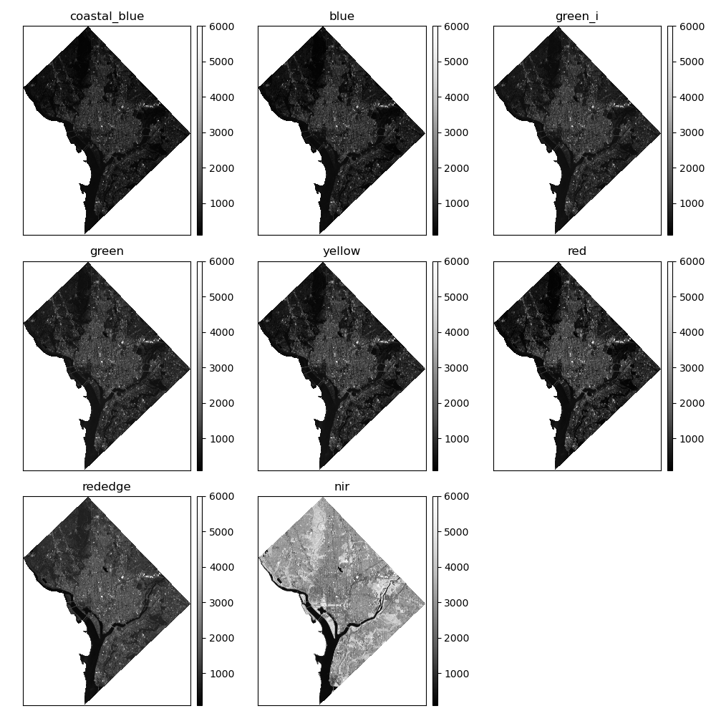

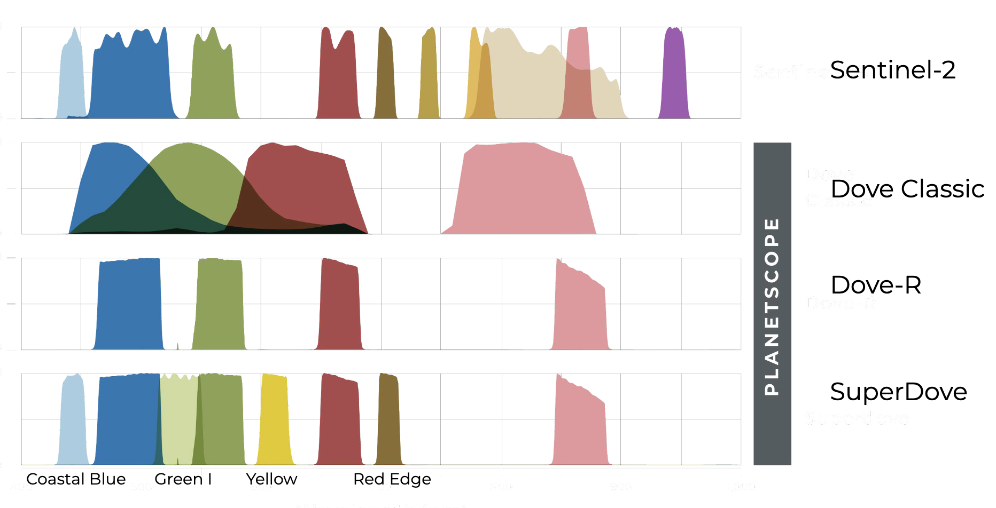
~3m spatial resolution
PlanetScope SuperDove 8-Band Imagery Composite for Washington, District of Columbia (June 5, 2022)
Notes:
Shown here are the 8 original bands from the PlanetScope SuperDove satellite.
They range from visible to near infrared and are collected at a spatial resolution of ~3m.
We found image tiles for a single day with 0% cloud cover (June 5, 2022).

Slide 10
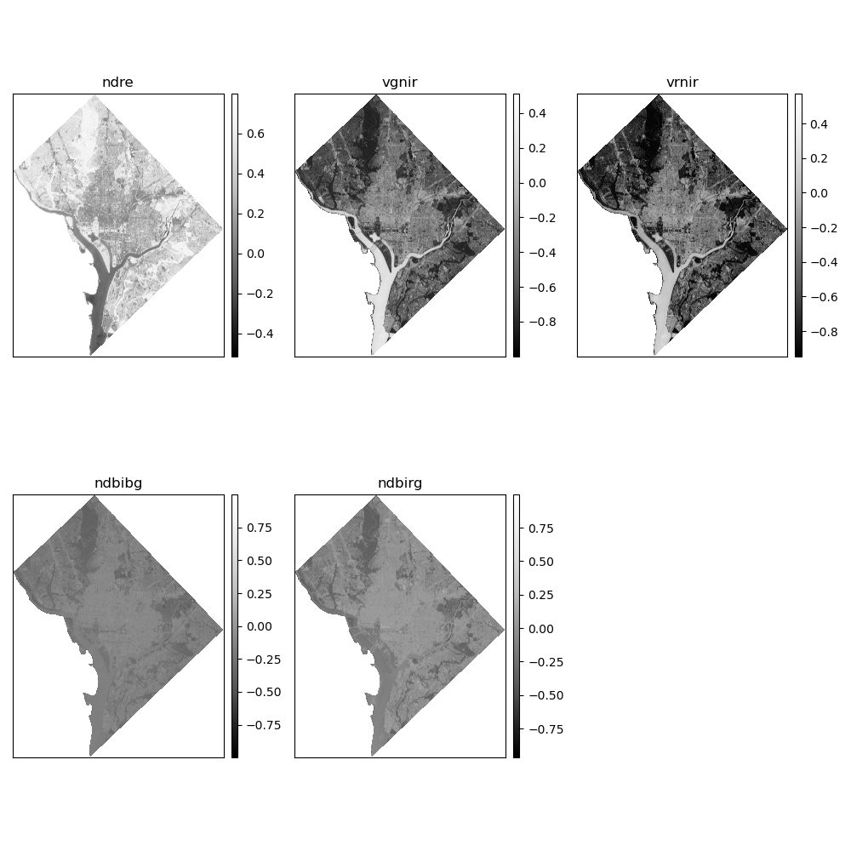
Spectral Indices
NDRE = Normalized Difference Red-edge Index
VGNIR = Visible Green-Near infrared Ratio
VRNIR = Visible Red-Near infrared Ratio
NDBIbg = Normalized Difference Built Index (blue/green)
NDBIrg = Normalized Difference Built Index (blue/green)
Javed, A., Cheng, Q., Peng, H., Altan, O., Li, Y., Ara, I., Huq, E., Ali, Y., & Saleem, N. (2021). Review of Spectral Indices for Urban Remote Sensing. Photogrammetric Engineering & Remote Sensing, 87(7), 513–524. https://doi.org/10.14358/PERS.87.7.513
PlanetScope SuperDove Spectral Indices for Washington, District of Columbia (June 5, 2022)
Notes:
We also generated a suite of spectral indices which have been shown to improve urban land cover mapping.
This resulted in a final image stack of 13 bands available for further processing.

Slide 11
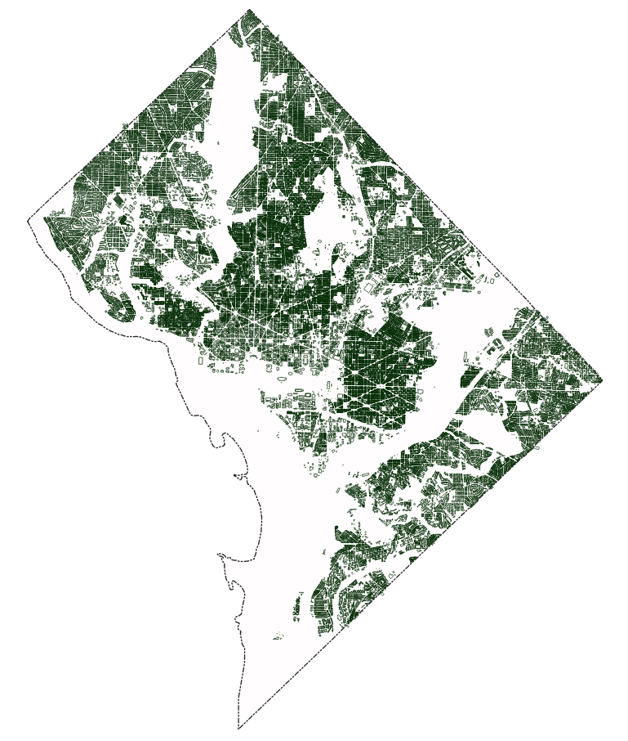
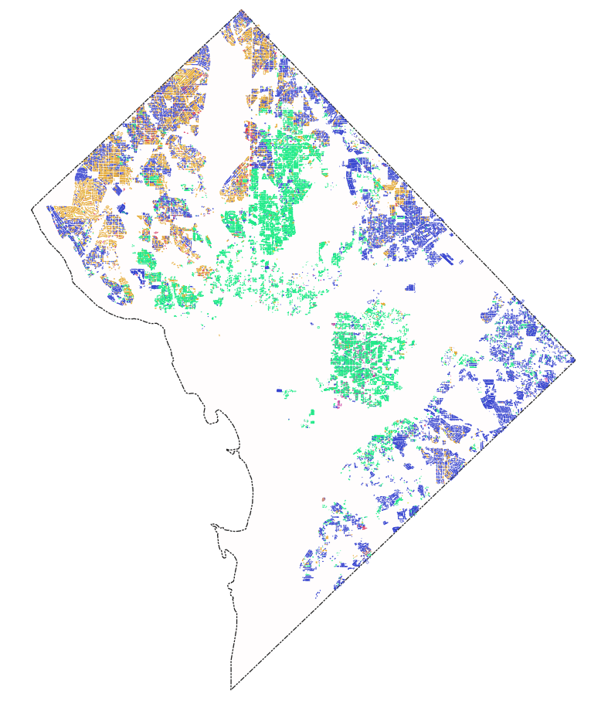
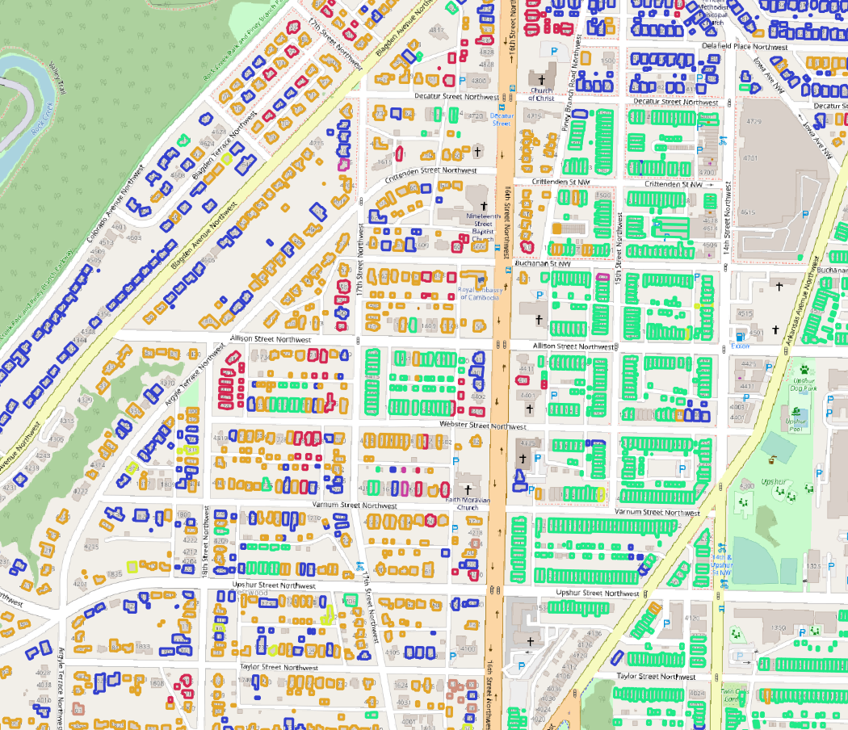

Filter footprints w/ missing roof material type
Code | Description
CS | Composition Shingle
ME | Metal
SH | Shingle
SL | Slate
TL | Tile
UR | Urethane
WS | Wood shake/shingle
Open Street Map Building Footprints + Zillow ZTRAX (data preparation by Johannes Uhl)
Notes:
Thanks to work by Johannes Uhl, we obtained matched OpenStreetMap building footprint polygons and Zillow ZTRAX property attributes.
This allowed us to generate a set of potential training data by filtering for footprints which have some information about the roofing material.

Slide 12
Code | Description
CS | Composition Shingle
ME | Metal
SH | Shingle
SL | Slate
TL | Tile
UR | Urethane
WS | Wood shake/shingle
Open Street Map Building Footprints + Zillow ZTRAX (data preparation by Johannes Uhl)
Notes:
Thanks to work by Johannes Uhl, we obtained matched OpenStreetMap building footprint polygons and Zillow ZTRAX property attributes.
This allowed us to generate a set of potential training data by filtering for footprints which have some information about the roofing material.

Slide 13
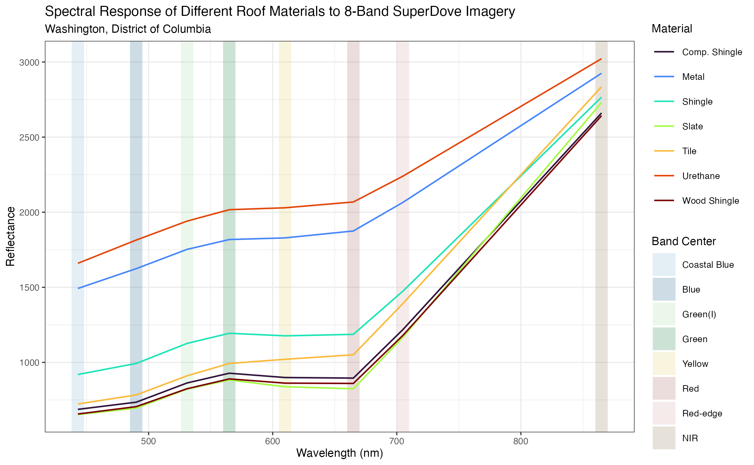
Wood shingle, composition shingle, and slate are very spectral similar …
Average spectral response of roof material types
Notes:
Shown here is the average spectral response of the different roof material types to the original 8 bands of the SuperDove imagery.
As you can see, there are some classes which have very similar spectral characteristics. This is a potential issue that we will talk about later.

Slide 14
Data Preparation
Spectral Mixture Analysis (SMA)
-Training Data Selection
Download PlanetScope SuperDove (8-bands)
Zillow ZTRAX
Open Street Map (OSM) Building Footprints
13-band image stack
Combined building footprints w/ Zillow attributes
Classification and Summary
Image composite & color balancing
Building footprints w/ joined Zillow attr.
MNF
Rasterize by roof cover code
Calculate spectral indices
Mask image stack
Filter for attr. completeness (roof material type)
Endmember selection (PPI)
Fully Constrained Least Squares (FCLS) LSMA
13-band image stack
Combined building footprints w/ attributes
Abundance Maps
Filter footprints where material abundance > .90
1
2
3
Notes:
Next, we feed this data into a spectral unmixing workflow to retrieve abundance maps of each material type.
This involved performing dimensionality reduction using the Minimum Noise Fraction transformation, creating a rasterized mask of each roof material type, and selecting candidate endmembers using the Pixel Purity Index.

Slide 15
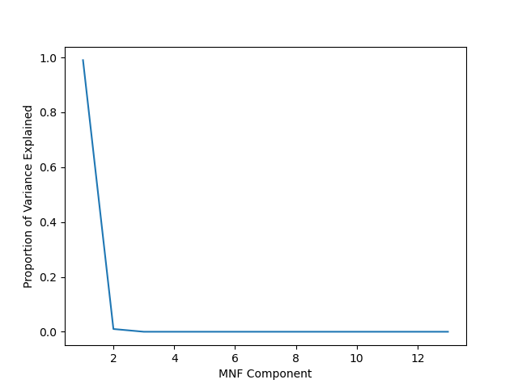
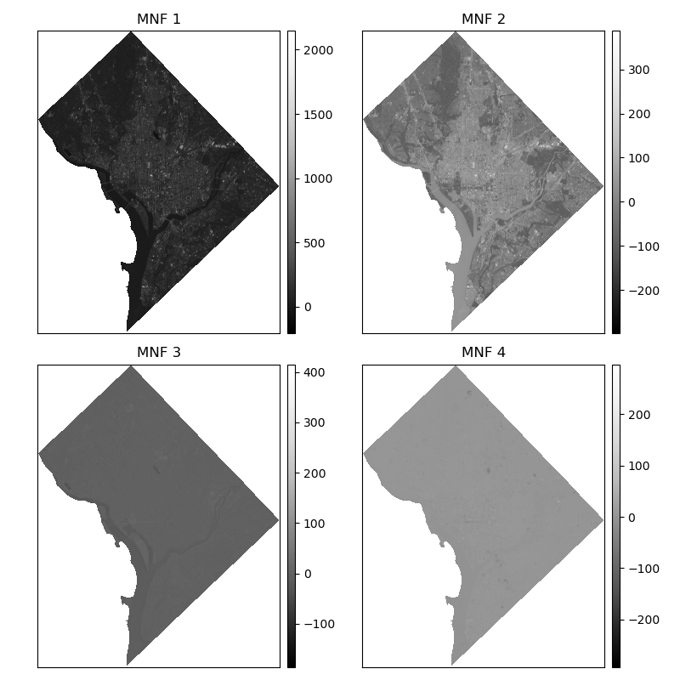
😅
The first two dimensions (really, the first one …) explain 99% of the variance from the 13 bands.
MNF 3 & 4 largely noise …
Dimensionality Reduction with Minimum Noise Fraction (MNF) Transformation
Notes:
Spectral Mixture Analysis benefits fr4om dimensionality reduction both in terms of accuracy and computational expense.
Due to the relative coarseness of the spectral resolution, the MNF transformation was able to capture 99% of the variance in the first two components.

Slide 16
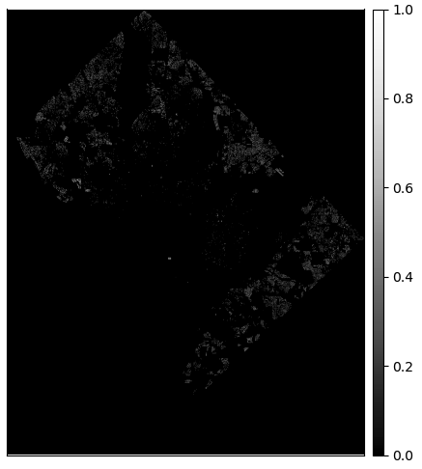
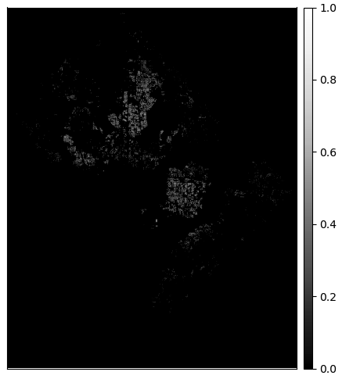
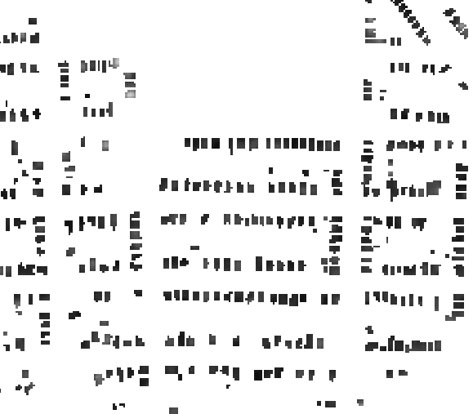
Composition Shingle (CS)
Metal (ME)
MNF data stack masked to CS building footprints
Roofing Material “Masks”
Notes:
We generated a rasterized mask of rooftop materials using the footprint polygons.
By masking the MNF transformed data by roof material type, we can then leverage automated workflows to identify candidate endmembers (pixels) within each group.
These endmembers are required as training for the LSMA.

Slide 17
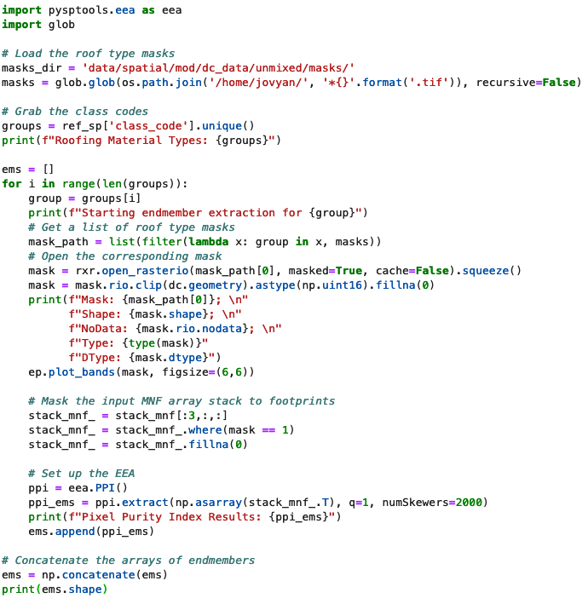
13-band image stack
Combined building footprints w/ Zillow attributes
MNF
Rasterize by roof cover code
Mask image stack
Endmember selection (PPI)
Fully Constrained Least Squares (FCLS) LSMA
Abundance Maps
Filter footprints where material abundance > .90
Endmember Selection with EEA ’PySpTools’ Pixel Purity Index (PPI)
Notes:
The result of endmember selection is an array of spectra representing each of the material types. In LSMA, the algorithm requires that there be one single endmember spectra per group.
Shown here is a snippet of Python code. I will provide a link to the GitHub repo for this project for anyone who is interested in the code.

Slide 18
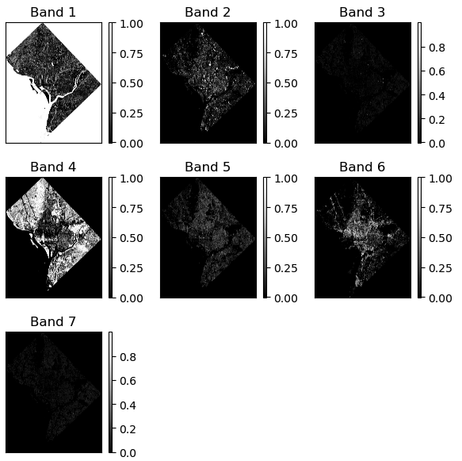
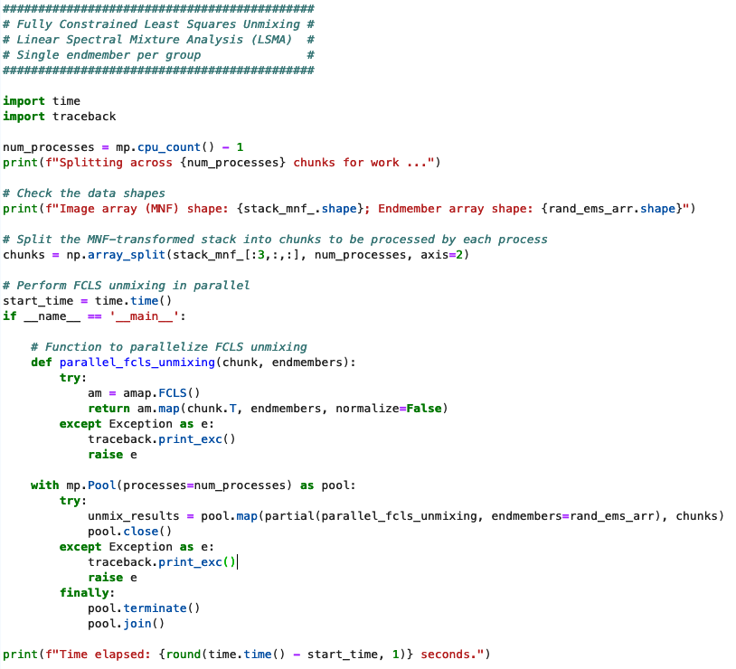
Abundance maps – parallel processing in the Amazon EC2
Notes:
Then, we generated the abundance maps with resulting pixel values relating to the estimated abundance of each type (constrained between 0 and 1).
This step is failrly computationally expensive, so we spun up an Amazon EC2 instance and performed the work in parallel.

Slide 19
Goal:
Leverage the LSMA results to filter out unreliable building footprint data and improve accuracy of Convolutional Neural Net (CNN) classifier (Resnet-18)
Hurdles:
Some materials have a small sample size.
Wood (WS), composite (CS) and shingles (SH) have similar spectral characteristics and many different shades and hues.
Endmember selection for LSMA requires ONE per class, and the within class variation is fairly high.
Spatial Filtering / Training Data Selection
Notes:
The goal of the LSMA is to improve training data for subsequent classifications.
However, some hurdles exist. Namely, small sample sizes and spectral similarity between classes results in mixed results (no pun intended).
Further analysis may be required, and we may benefit from having more detail spectral information e.g., hyperspectral)

Slide 20
Data Preparation
Spectral Mixture Analysis (SMA)
-Training Data Selection
Download PlanetScope SuperDove (8-bands)
Zillow ZTRAX
Open Street Map (OSM) Building Footprints
13-band image stack
Combined building footprints w/ Zillow attributes
Classification and Summary
Image composite & color balancing
Building footprints w/ joined Zillow attr.
Filtered footprint data (training)
13-band image stack
MNF
Rasterize by roof cover code
Calculate spectral indices
Mask image stack
Filter for attr. completeness (roof material type)
Extract spectral information
Endmember selection (PPI)
Fully Constrained Least Squares (FCLS) LSMA
Split into train/test/ validation sets
13-band image stack
Combined building footprints w/ attributes
CNN (Resnet-18)
Abundance Maps
Filter footprints where material abundance > .90
1
Classified root material types
2
3
Notes:
The final step in this project will be to leverage our LSMA results to improve on an existing model infrastructure from past OPP work.
This process involves fitting a Convolutional Neural Network

Slide 21
Thank you!
https://github.com/maxwellCcook/opp-urban-fuels/tree/main/rooftop-materials
maxwell.cook@colorado.edu

